Slide 1
L1C – PSet – Validation
Pointing Set L1C Products
Aug, 2025
Nick Dutton

Slide 2
Goals
Validate Pointing Set L1C Products

Slide 3
Validation Process
For each item we will check the following:
  Does the CDF contain the appropriate items in reasonable format?
  Are the computed values / outputs consistent with expected outputs?
  Does the input used check enough items to move forward?
Files addressed in this presentation
  Ref website: https://lasp.colorado.edu/galaxy/spaces/IMAP/pages/193401441/Ultra+Algorithm+Development+Milestone
  imap_ultra_l1c_90sensor-spacecraftpset_20250513_v001.cdf

Slide 4
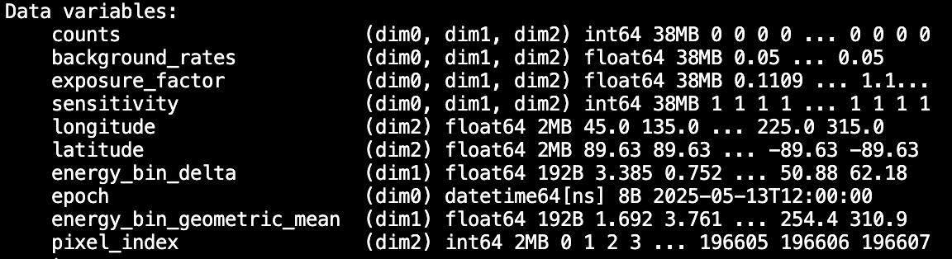
Pointing Set – (1) Appropriate Items
  imap_ultra_l1c_90sensor-spacecraftpset_20250513_v001.cdf
Requests / Comments:
Add another field for “scatter” (dim1, dim2)
Add another field for “scatter_threshold” (dim1)
Keep “sensitivity”, but also report:
  “geometric_function” (dim1, dim2)
  “efficiency” (dim1, dim2)
Since exposure time will now vary per pointing due to
dead-time corrections, the dead-time ratio should also
be tracked.
  “dead_time_ratio” and should be a 1-D function
  against spin phase. The dimensions of this will be
  different than those of pixels – not sure how CDF
  handles this; this could even be in a different CDF
It is important to either track the L1B products used to
create this L1C CDF, and/or report the SPICE kernels
used in its construction. Note the comment from the
L2 field descriptors on SPICE kernels:
https://docs.google.com/document/d/1_TXRCy1cMHgEjCNcUoekcg3w1Zwe3oDyeunHVtw5Wdc/edit?tab=t.0
Don’t see a descriptor for Species, or CG or spacecraft inside the file (okay to have just in filename?)
Dim0 | Dim1 | Dim2
Pointing # / Epoch | Energy Bin | HP Pixel Index
Requests / Comments / Questions:
No units on any of the fields. Please add those attributes
Assume “epoch” values represent midpoint of the Pointing?
Add “energy_bin_boundaries”, (or “energy_delta_minus” & “energy_delta_plus” as in L2 example) or equivalent. The delta & geometric mean will not necessarily tell the start and stop points of the energy bins. Feel free to keep the delta or remove
In L2 CDFs “energy” (geometric mean) is listed as a coordinate, perhaps do the same here to be consistent?
Add ”culling_mask” for Earth based culling Ultra-45

Slide 5
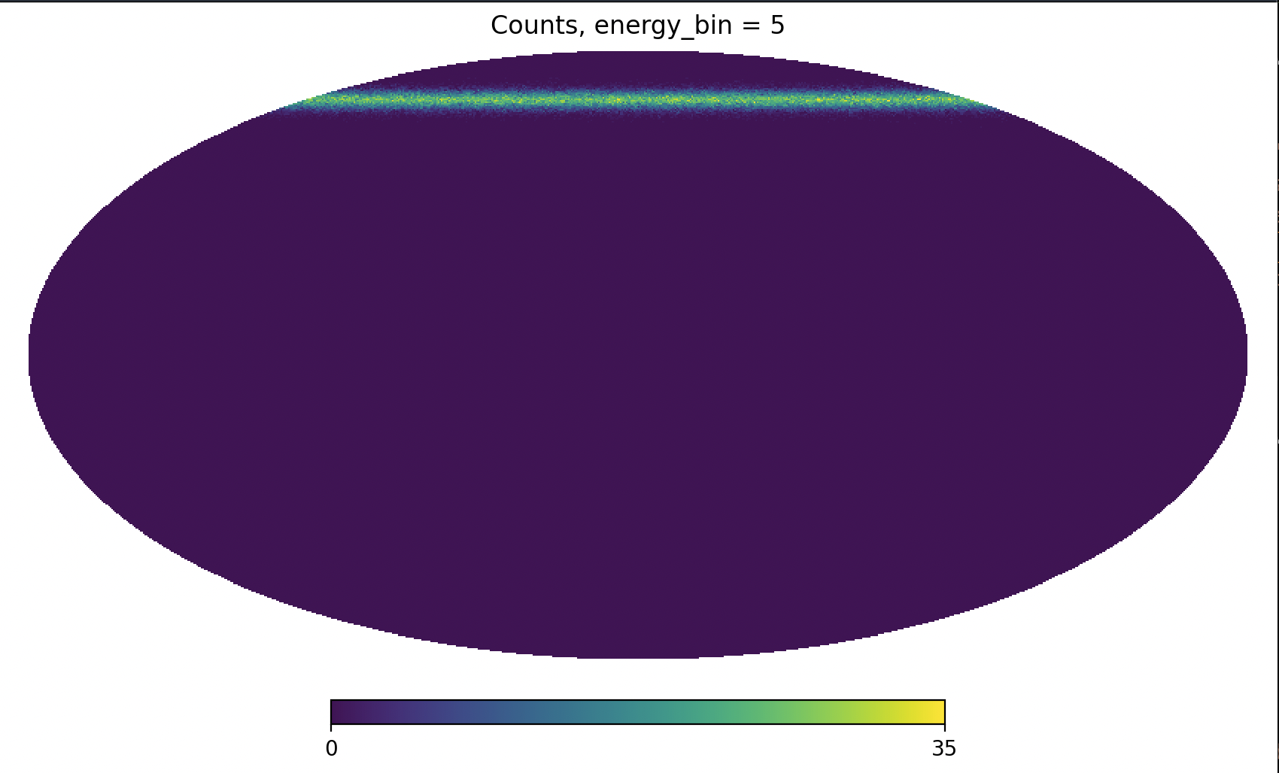
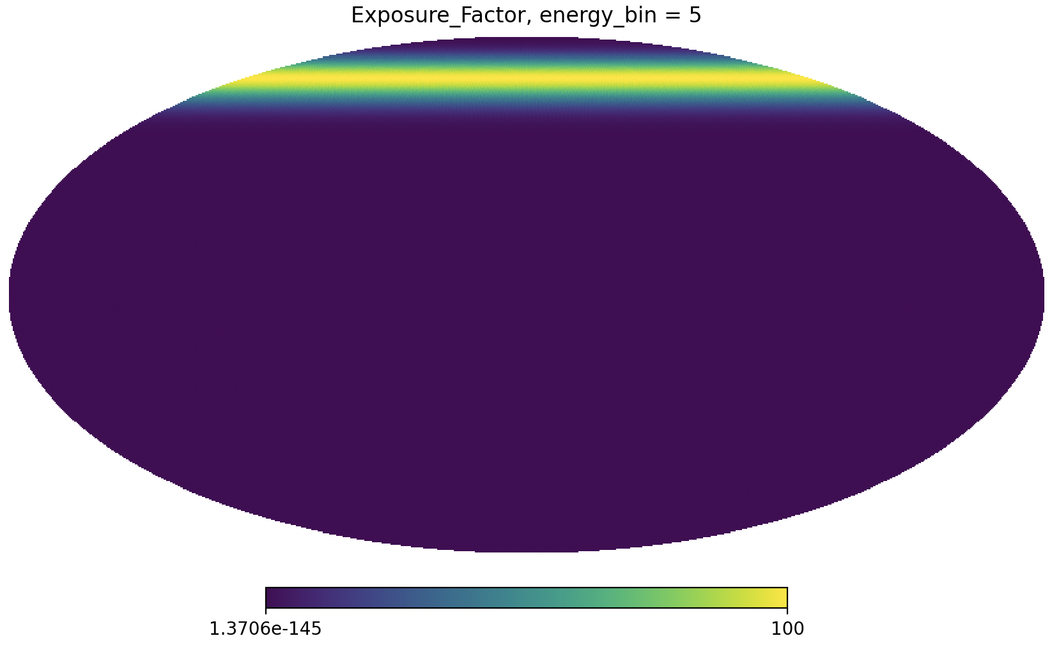
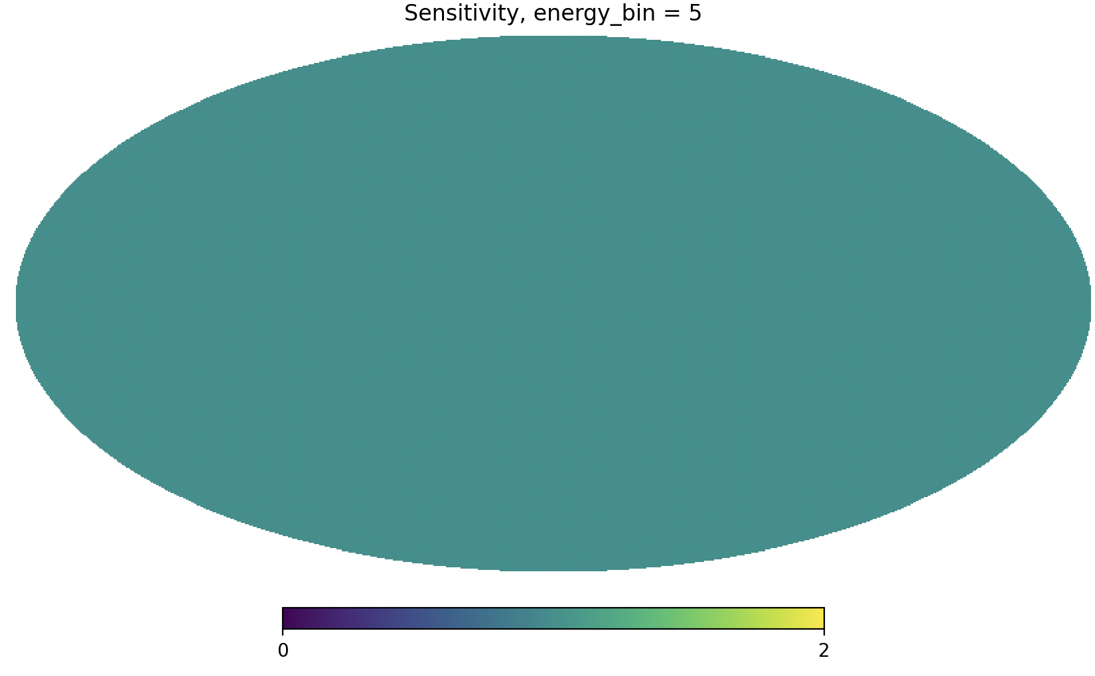
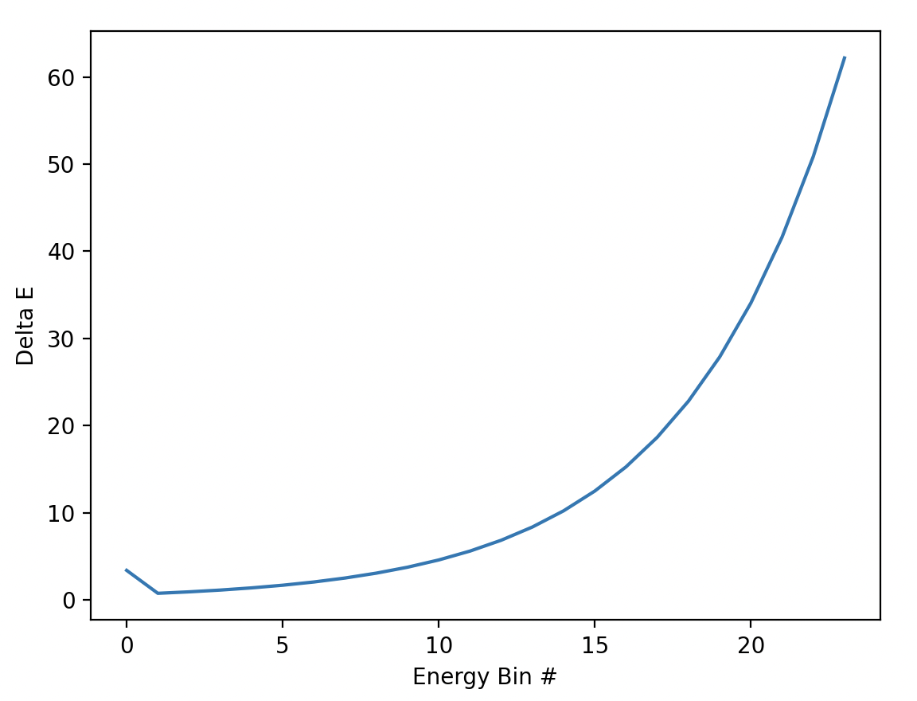
Pointing Set – (2) Expected Outputs
Selected Items Checked for this Product:
Counts & Exposure maps looks reasonable?
Sensitivity looks reasonable?
Energy bin delta
①
Counts and Exposure Time Maps do not look properly implemented to date
②
Sensitivity all 1
Due to forcing E = 0 to start?
③

Slide 6
Pointing Set – (3) Right info for validation?
We’d like to use the simulated L1B data binned to L1C to create the CDFs if possible. This will allow use to validate against the sim in terms of mapping and data products
The files currently only have a single Pointing in them. Multiple will be needed for L2 map validation.

