Slide 1
L2 – Map – Validation
Flux Maps, etc.
Aug, 2025
Nick Dutton

Slide 2
Goals
Validate L2 Mapping CDF Products

Slide 3
Validation Process
For each item we will check the following:
  Does the CDF contain the appropriate items in reasonable format?
  Are the computed values / outputs consistent with expected outputs?
  Does the input used check enough items to move forward?
Files addressed in this presentation
  Ref website: https://lasp.colorado.edu/galaxy/spaces/IMAP/pages/193401441/Ultra+Algorithm+Development+Milestone
  imap_ultra_l2_90sensor-enamaphealpix-hf-99mo_20250501_v999.cdf
  (SIT-4) imap_ultra_l2_u45-ena-h-sf-nsp-full-hae-2deg-3mo_20260101_v001.cdf

Slide 4
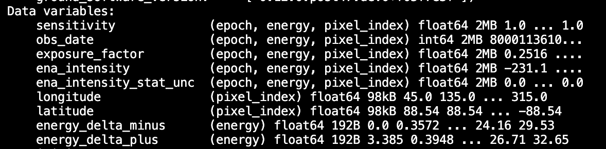
L2 Map – (1) Appropriate Items [Galaxy Page CDF]
Requests / Comments:
Add another field for “counts” (energy, pixel_index)
Add another field for “positional_uncertainty” (energy, pixel_index); units will be degrees
Keep “sensitivity”, but also report:
  “geometric_function” (energy, pixel_index)
  “efficiency” (energy, pixel_index)
It is important to either track the L1C products used to
create this L2 CDF, Note the comment from the
L2 field descriptors on SPICE kernels:
https://docs.google.com/document/d/1_TXRCy1cMHgEjCNcUoekcg3w1Zwe3oDyeunHVtw5Wdc/edit?tab=t.0
Don’t see a descriptor for Species, or CG or spacecraft inside the file (okay to have just in filename?)
”obs_date” is the mean date date for all dates used to accumulate into a pixel. Please also add “obs_date_std” (ref: Ultra Algorithm Doc Section 3.5.7) and “obs_date_range” as produced in SIT-4
Add “solid_angle” of the healpix as an attribute
  imap_ultra_l2_90sensor-enamaphealpix-hf-99mo_20250501_v999.cdf

Slide 5
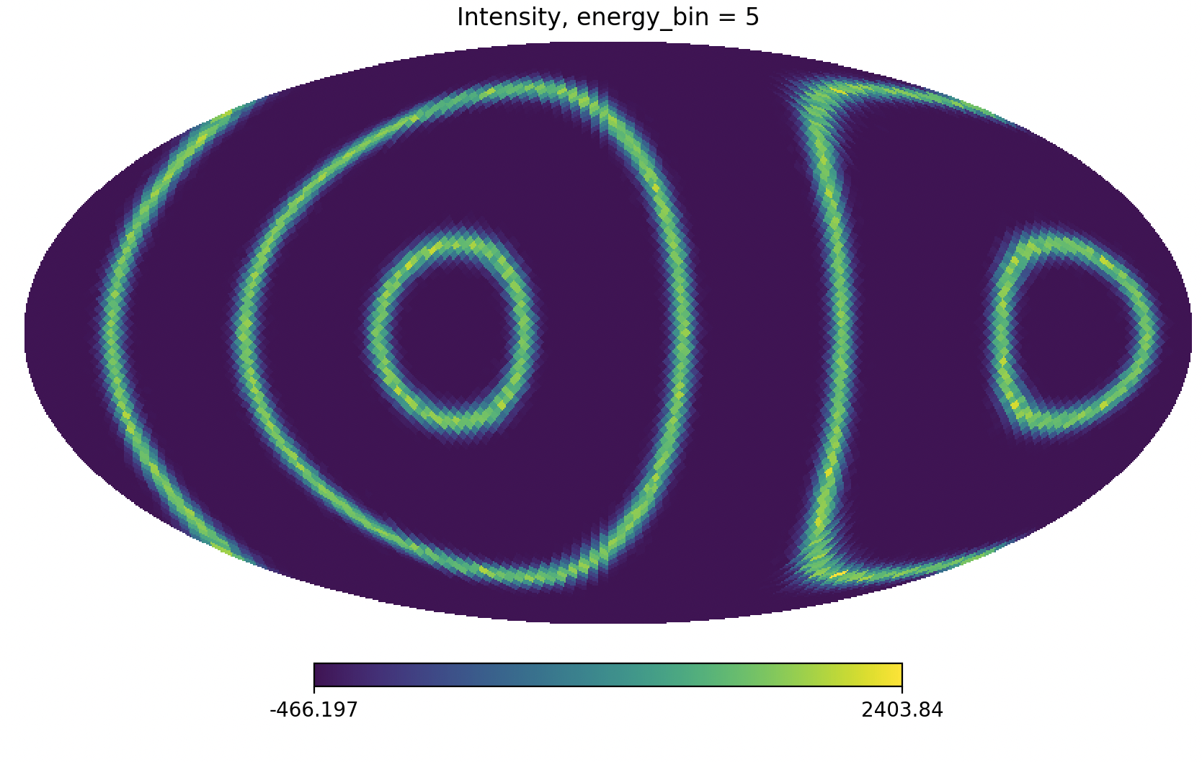
L2– (2) Expected Outputs [Galaxy Page CDF]
Selected Items Checked for this Product:
Intensity
①
Intensity produced from L1C with single line? I would expect there to be a single circle here also. Just don’t now how this was created

Slide 6
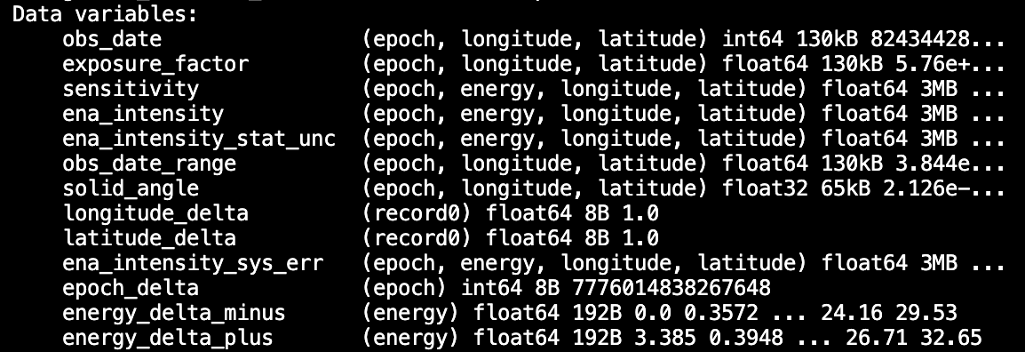
L2 Map – (1) Appropriate Items [SIT-4]
Requests / Comments:
Add another field for “counts” (energy, lon, lat)
Add another field for “positional_uncertainty” (energy, pixel_index); units will be degrees
Keep “sensitivity”, but also report:
  “geometric_function” (energy, pixel_index)
  “efficiency” (energy, pixel_index)
It is important to either track the L1C products used to
create this L2 CDF, Note the comment from the
L2 field descriptors on SPICE kernels:
https://docs.google.com/document/d/1_TXRCy1cMHgEjCNcUoekcg3w1Zwe3oDyeunHVtw5Wdc/edit?tab=t.0
  SPICE kernels are here listed under “Parents” but there are several items missing that I currently don’t see but could be missing them.
    ”Psets, Ancillary input file names, Calibration Product Reference, Species, etc”
Don’t see a descriptor for Species, or CG or spacecraft inside the file (okay to have just in filename?)
Add “obs_date_std” (ref: Ultra Algorithm Doc Section 3.5.7)
  (SIT-4) imap_ultra_l2_u45-ena-h-sf-nsp-full-hae-2deg-3mo_20260101_v001.cdf
Requests / Comments / Questions:
What do “longitude_delta” and “latitude_delta” represent? This is a 2 deg map. The 2.0 degree map spacing is represented in an attribute named “Spacing_degrees”
Add “background_rates”

Slide 7
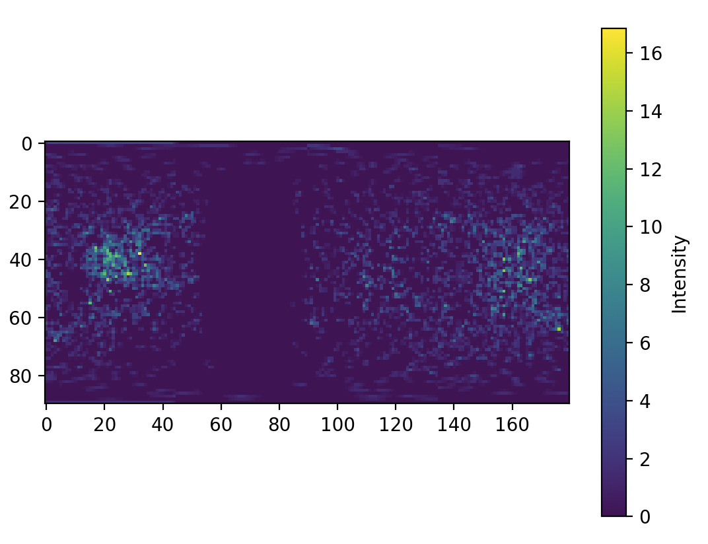
L2 SIT4 – (2) Expected Outputs
Selected Items Checked for this Product:
Intensities?
①
Intensities look odd for 3 months of data. Also not sure how this was built.

