Slide 1
Exposure Time Adjustment Algorithm
Dead Time adjustment - prototype

Slide 2
Sectored Spin CONOPS
3 times per day (Pointing) for 20 minutes each, Ultra will produce image mode rates packets in sector mode
These packets need to be distinguishable to the SOC as they will be used to build a start rate vs spin-phase function at each spin sector
  I believe this is an open discussion… Should:
    N1 be changed?
    Should the header be altered?

Slide 3
Building Dead-Time Correction Factor
The packet data in sectored mode is selected and for each sector the following process is used to build a dead-time correction ratio vs spin-phase. Majority of these terms come from the Hardware Event Counters (See Table 7 FSW Document)
  Valid Events, Event Active Time, Start Position TDCVE, Start Right Full CFD, Start Left Full CFD, CoinTopNorthCFD, CoinBottomNorth CFD, StopTopNorth CFD, StopBottomNorth CFD
A = Valid Events/(1 – (Event Active Time + 2 * StartPositionTDCVE)*1E-7)
B = A * EXP(StartRightFullCFD + StartLeftFullCFD)*1E-7*5)
Corrected Valid Events = B * EXP(1E-7*8*(CoinTopNorthCFD+CoinBottomNorthCFD – StopTopNorthCFD –StopBottomNorthCFD))
Dead Time Ratio = Valid Events / Corrected Valid Events

Slide 4
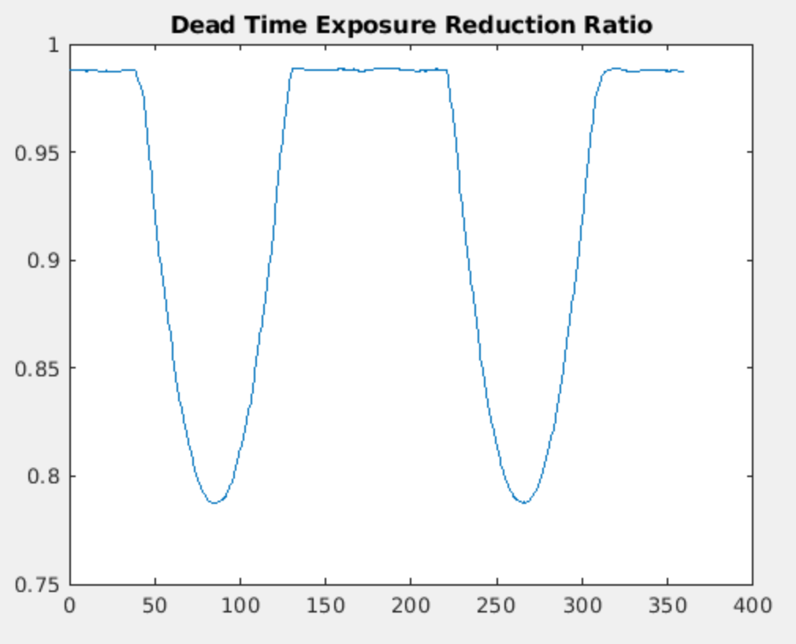
Dead-Time Correction Function
The Dead-Time Ratio is computed and stored for every sector in which there is data as a function of spin phase
For each Pointing, take the accumulated data of dead-time ratio vs spin-phase and median the data at each spin phase and use a piecewise cubic Hermite interpolation (PCHIP) approach to fit the data to a function for later interpolation
An overly simplified example of such a dead-time ratio function may look as follows:

Slide 5
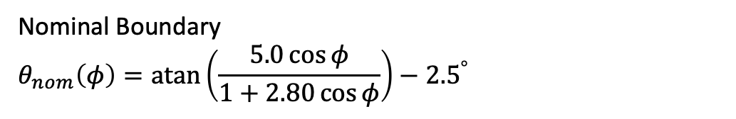
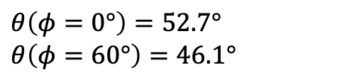
Dead-Time Correction Application
For each Pointing, the exposure time duty cycle (dead-time) must be adjusted to account for times in which the instrument was not listening for valid events
In order to do this the exposure time at L1C (in the Pointing Frame) must be adjusted.
Starting at Spin-Phase = 0, and incrementing in fine steps (1 ms), spin the spacecraft in the despun frame. At each iteration, query the dead-time ratio from the function previously built and apply the nominal exposure time (the time step) to every pixel in the Field of Regard (FOR) multiplied by the dead-time ratio.
At each step, use the theta / phi dependence that defines the Field of View (FOV) as a selection criteria in which to accumulate time into that pixel or not
Nominal Boundary
$$θ_{nom}\left(φ\right)=\operatorname{atan}\left(\frac{5.0\cos{φ}}{1+2.80\cos{φ}}\right)−{2.5}^{°}$$
$$θ\left(φ=0°\right)=52.7°$$
$$θ\left(φ=60°\right)=46.1°$$

Slide 6
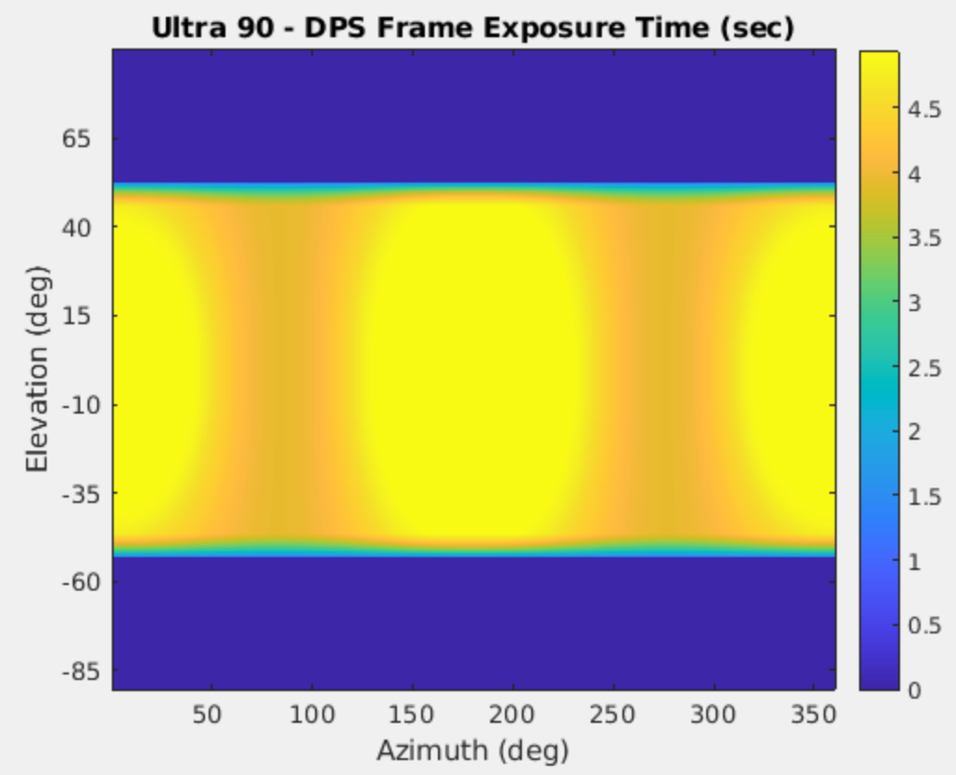
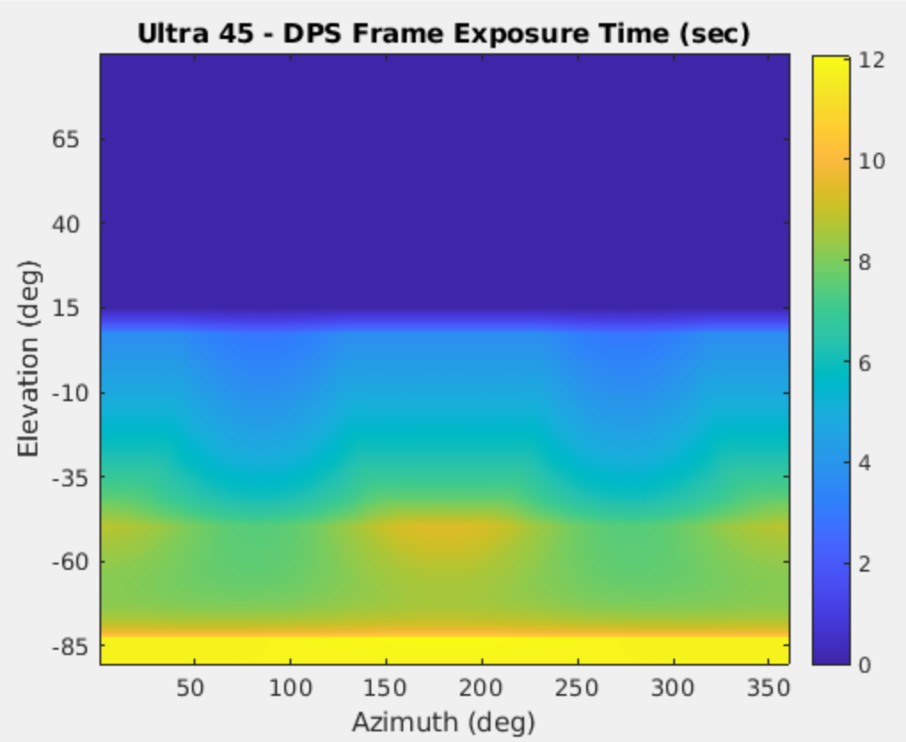
Reduced Exposure Times – Notional Examples
Ultra-45 start rates will look different – I’ve used the same ones observed for Ultra-90 Here…

